Slide 1
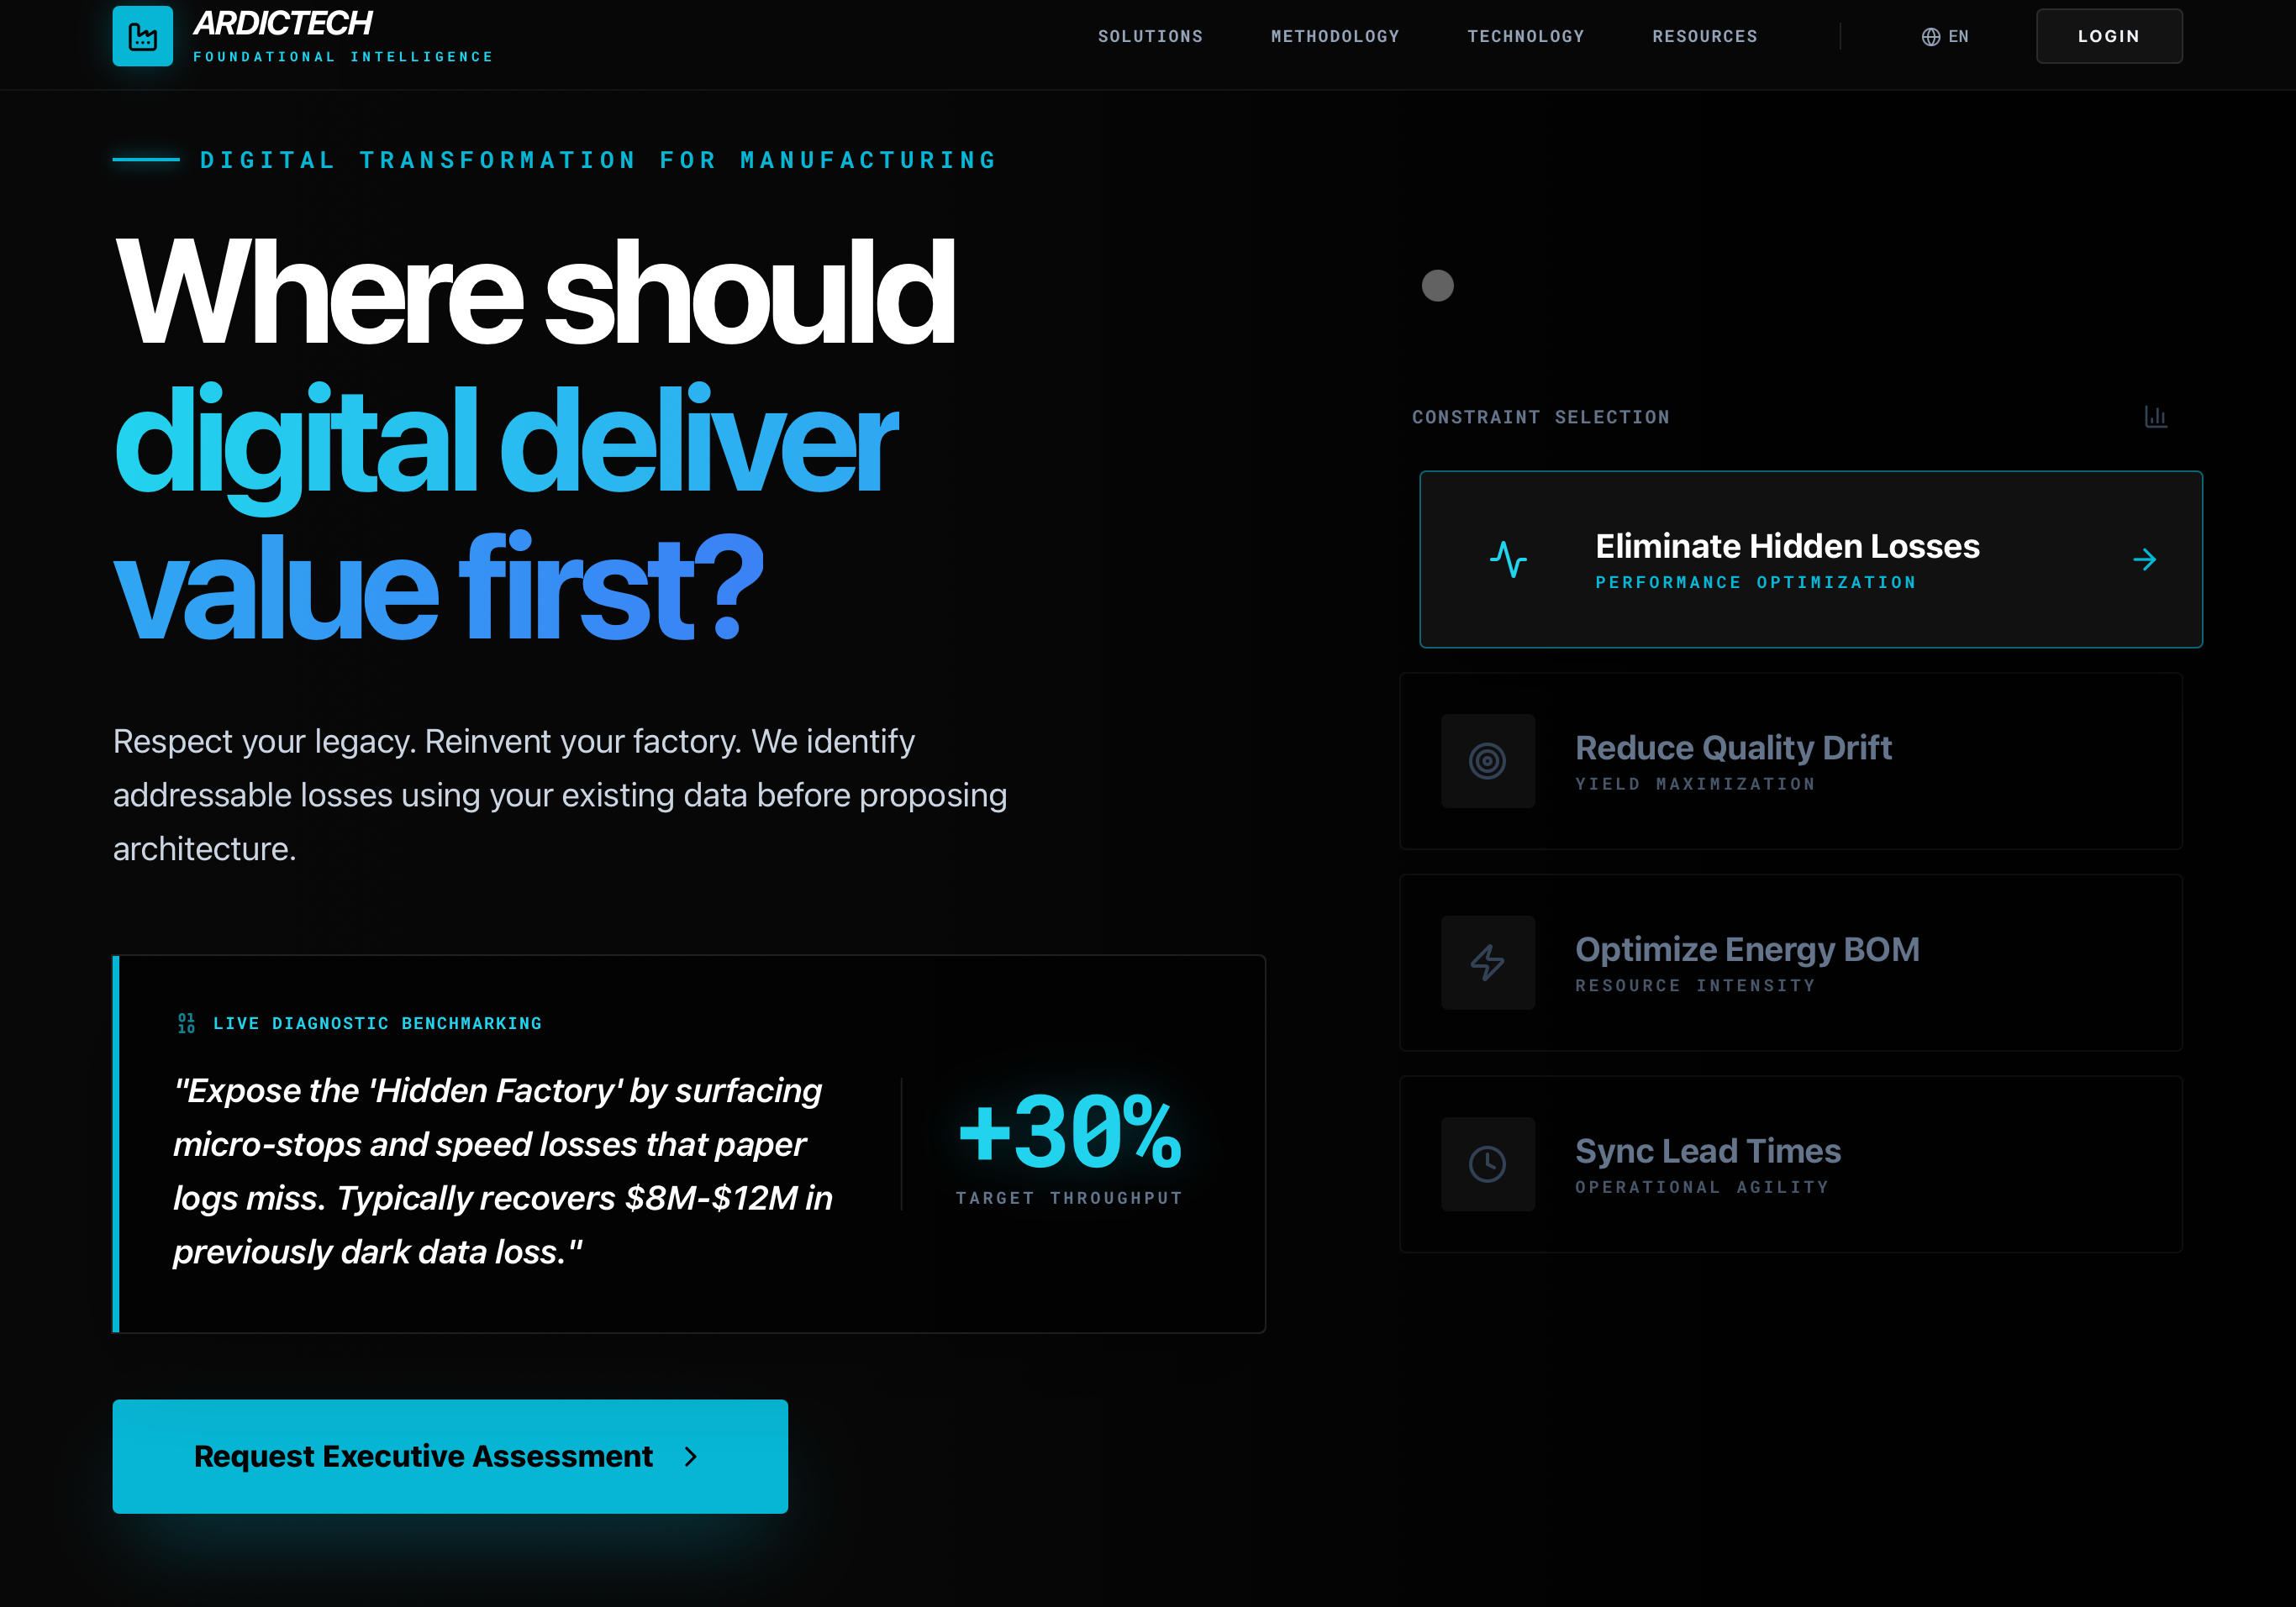

Slide 2
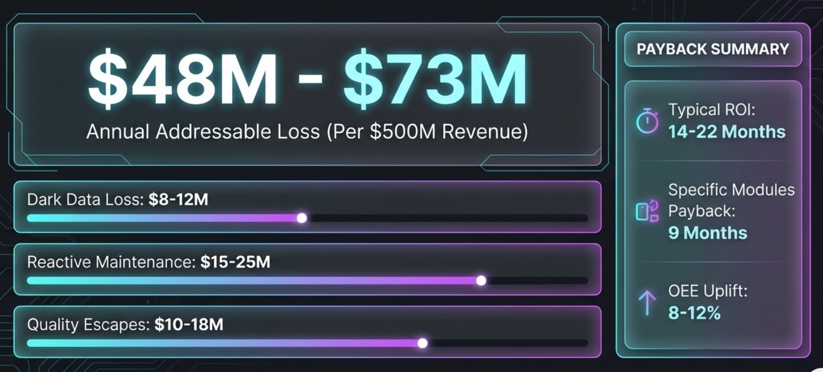
UNSEEN DATA.
SILENCED VALUE.
UNTAPPED POTENTIAL.
DARK DATA INSIGHT
"Valuable signals are trapped in legacy silos. We unlock this 'Dark Data' for production truth."
OEE LEAK
INSIGHT
"Recovering hidden capacity lost to micro-stoppages that traditional systems cannot see."
DOWNTIME DRAIN
INSIGHT
"Recovering hidden capacity lost to micro-stoppages that traditional systems cannot see."
EBIDTA GROWT
INSIGHT
"Recovering hidden capacity lost to micro-stoppages that traditional systems cannot see."

Slide 3
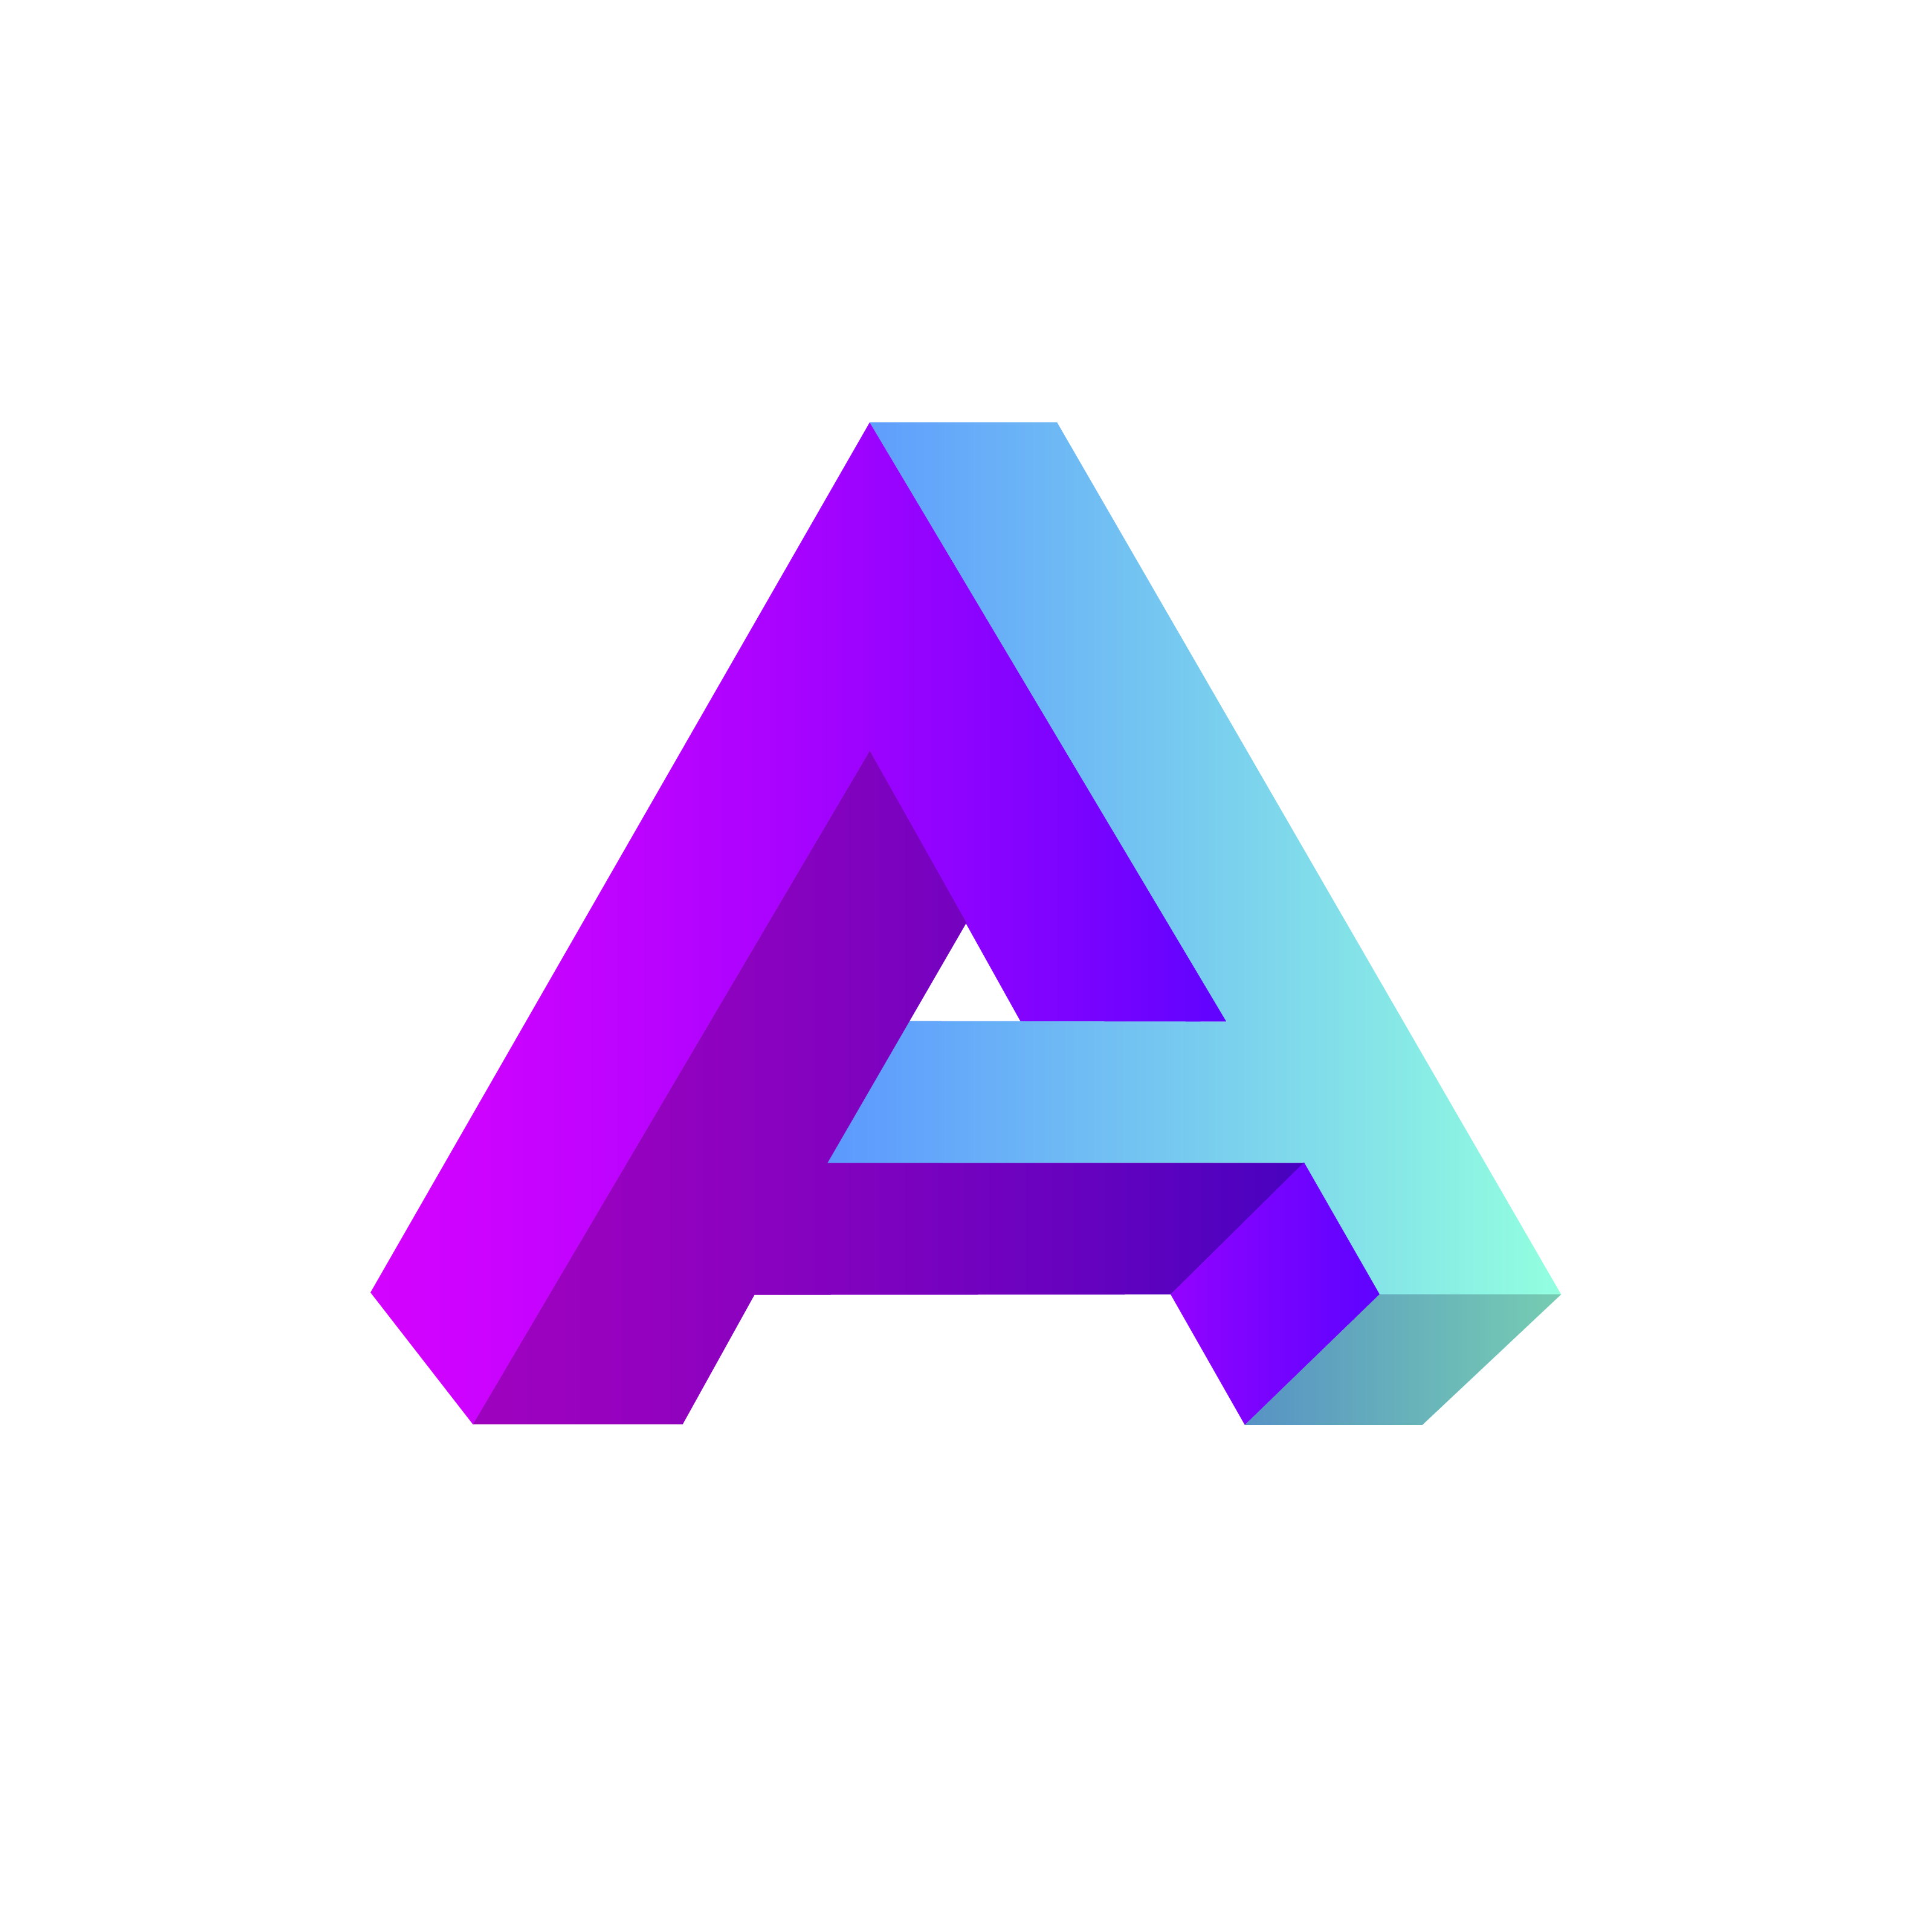


WE DONT AIM FOR STATIC PERFECTION
BUT DYNAMIC PRECISION
Operational Ensō:
COMLETE AND
INCOMPLETE
AT HE SAME TIME
Real Transformation is not a one-time project; It is is a living circle! A Circle of Continuous ”Becoming
Alive, Evolving and Always in Motion
Enso is a hand-drawn circle in Japanese Zen art, simple shape with a deep message: presence, clarity, and the idea that everything is connected
Notes:
Pull data from legacy systems via APIs → Bunu taahhüt olarak alırlarsa sıkıntı yaşar mıyız? Legacy Sistemlerden API ile veri çekmek çok mümkün olamayabilir zira

Slide 4
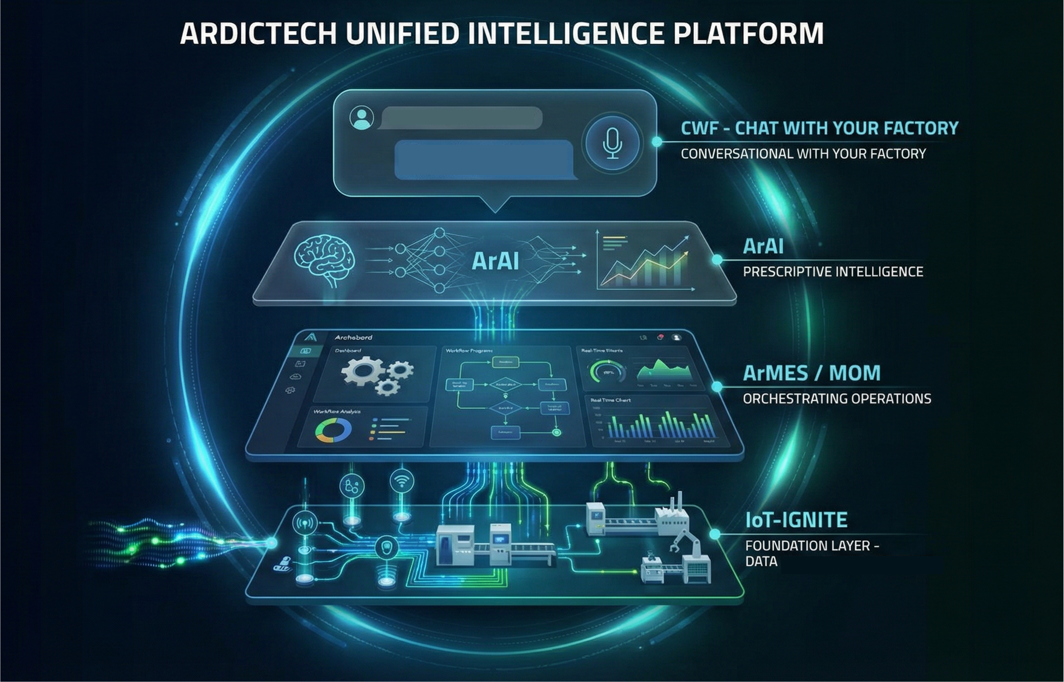
Your Path to Ensō, at Your Pace
For an Existing Stack
We connect and enhance, don’t replace. Our platforms are open by design.
For a Clean State
A full-stack 4-layer deployment from scratch. Go from zero to full visibility.
Seamless Integration
Connect via read-only APIs
Ingest ‘Dark Data’ to a Data Lake
Deploy the CWF - ‘Truth Layer’
Rapid Deployment
IoT-Ignite sensors and gateways
Full ArMES implementation
Immediate Visibility (weeks, not years)
Ideal for: companies looking to augment current systems or unlock stalled projects
OUR APPROACH :
Act as the ‘Intelligence Wrapper’
Pull data from legacy systems via APIs
Enrich it with AI
Deliver it via conversational Interface
Ideal for: companies starting or re-platforming their digital journey.
Notes:
Pull data from legacy systems via APIs → Bunu taahhüt olarak alırlarsa sıkıntı yaşar mıyız? Legacy Sistemlerden API ile veri çekmek çok mümkün olamayabilir zira

Slide 5
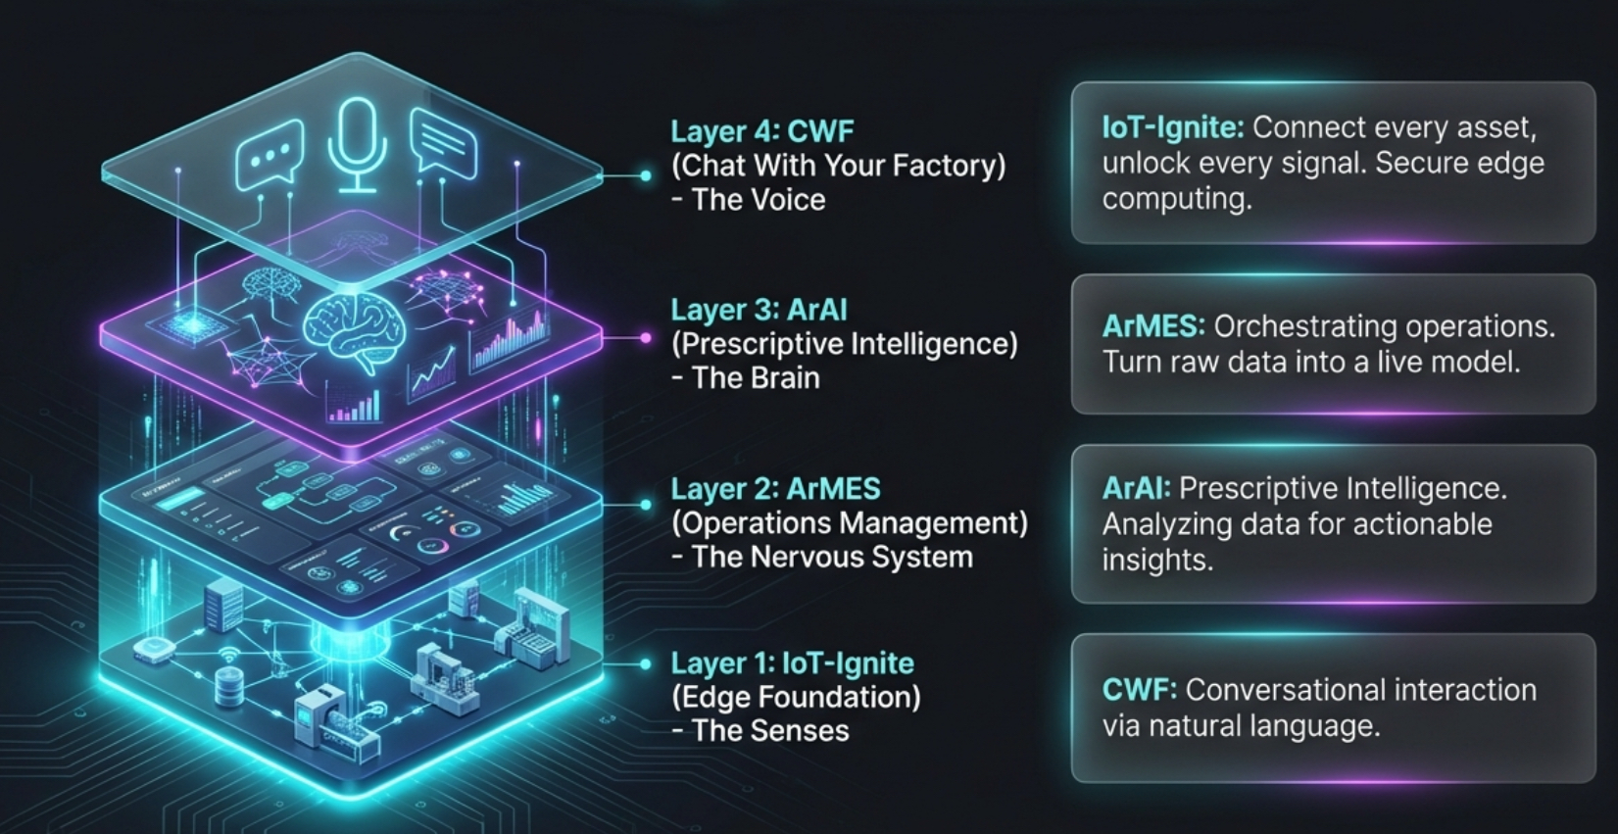
A Unified 4 layer Architecture

Slide 6
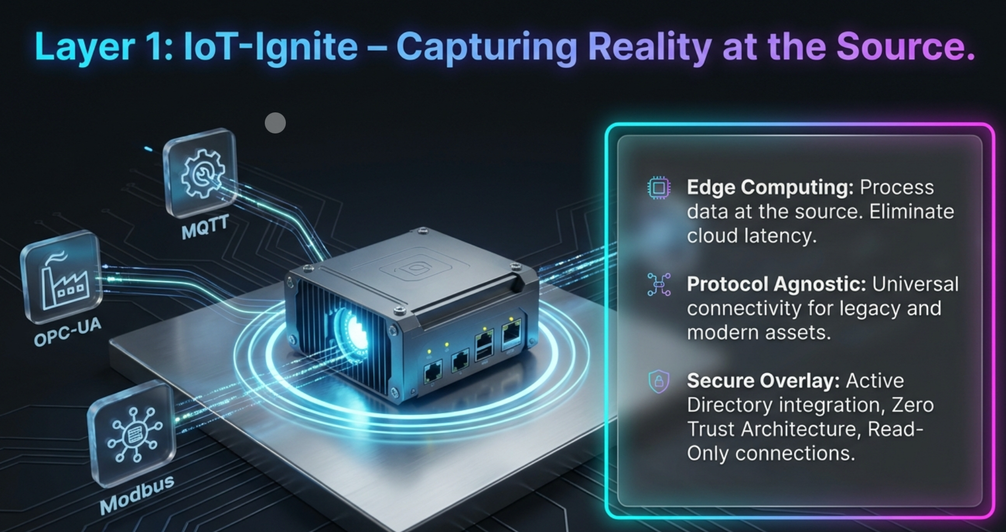

Slide 7
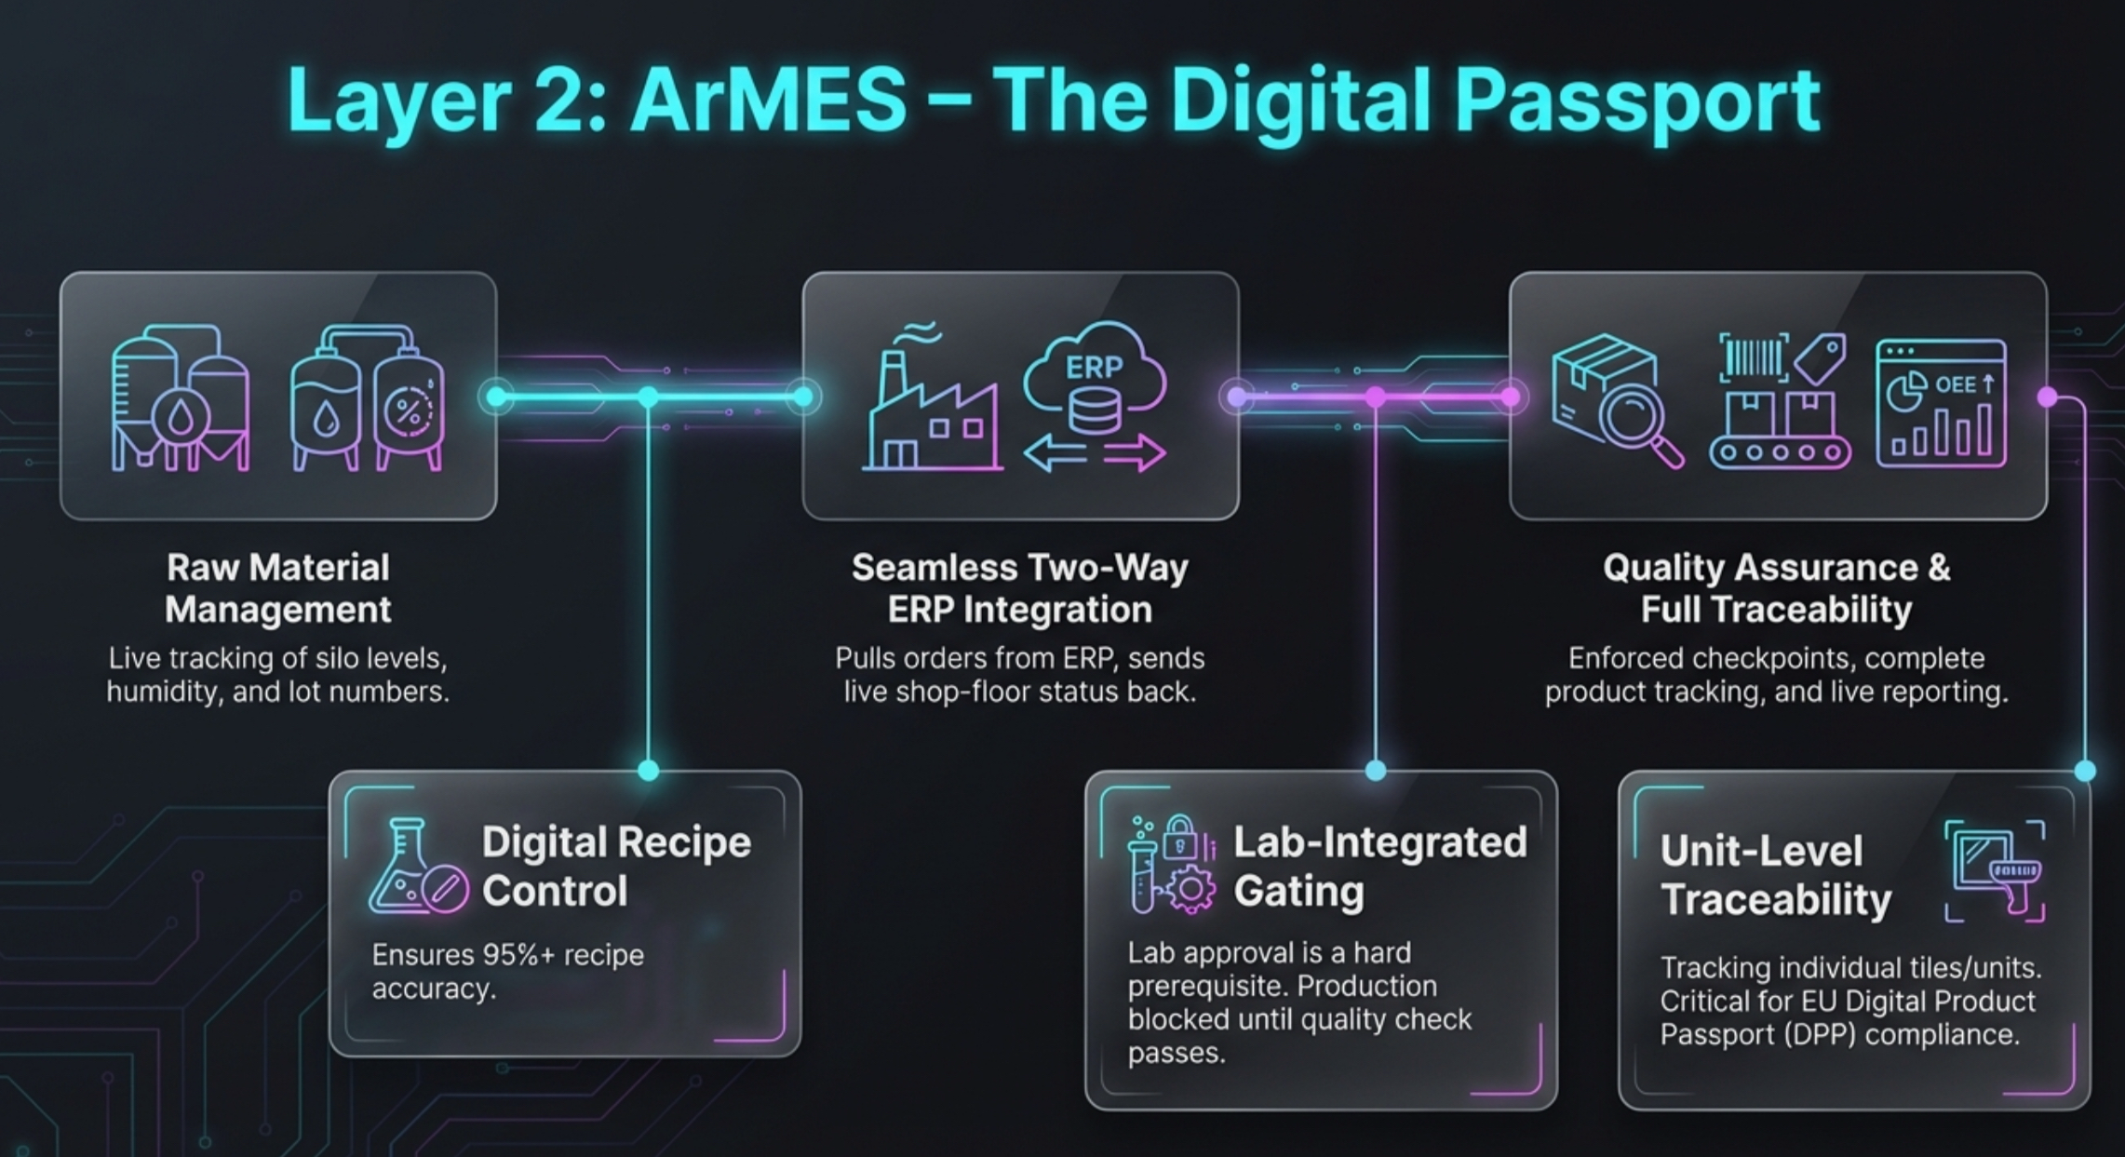

Slide 8
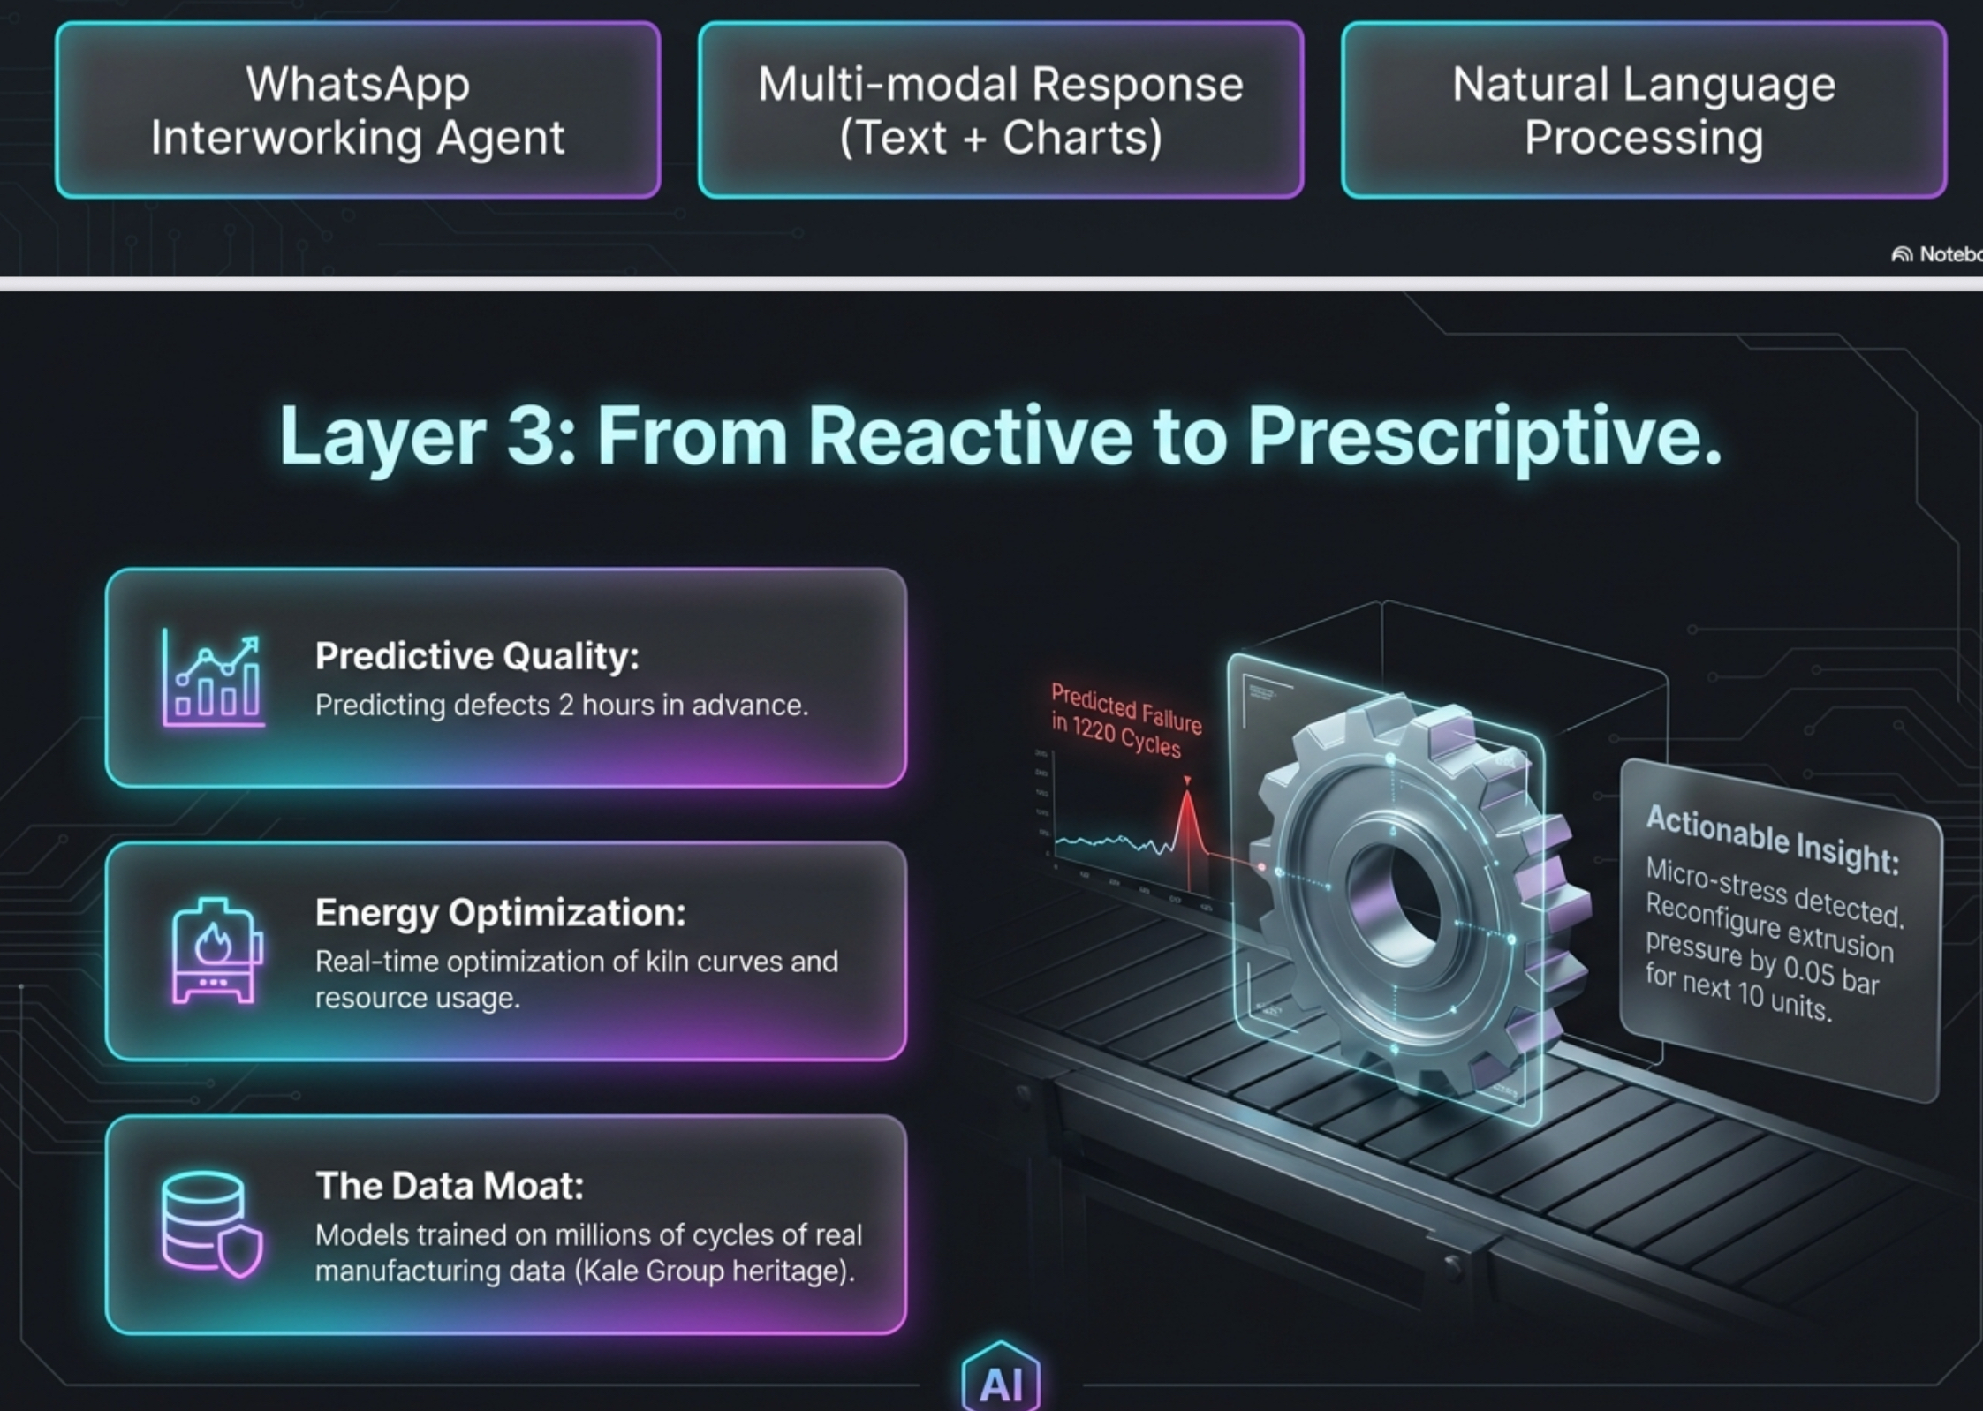

Slide 9
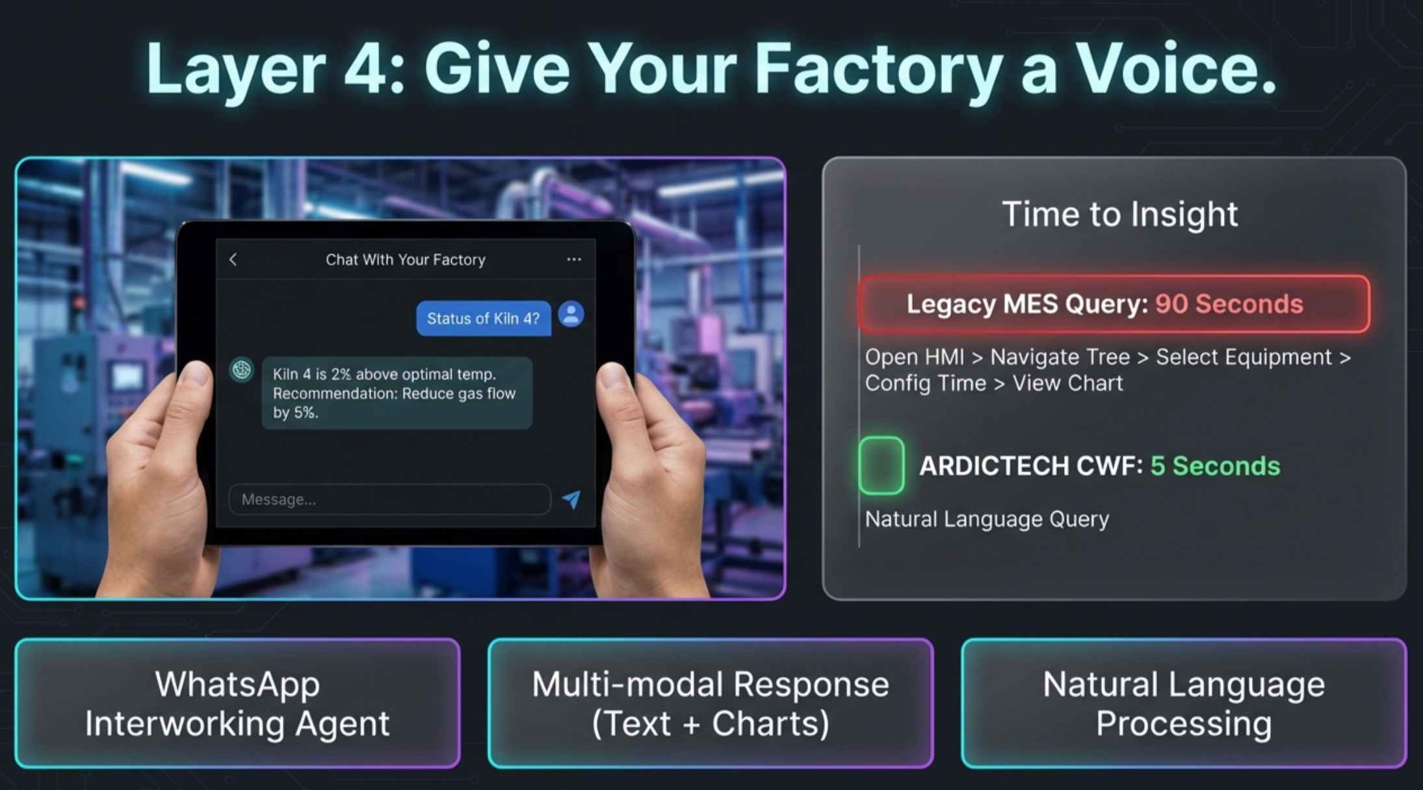

Slide 10
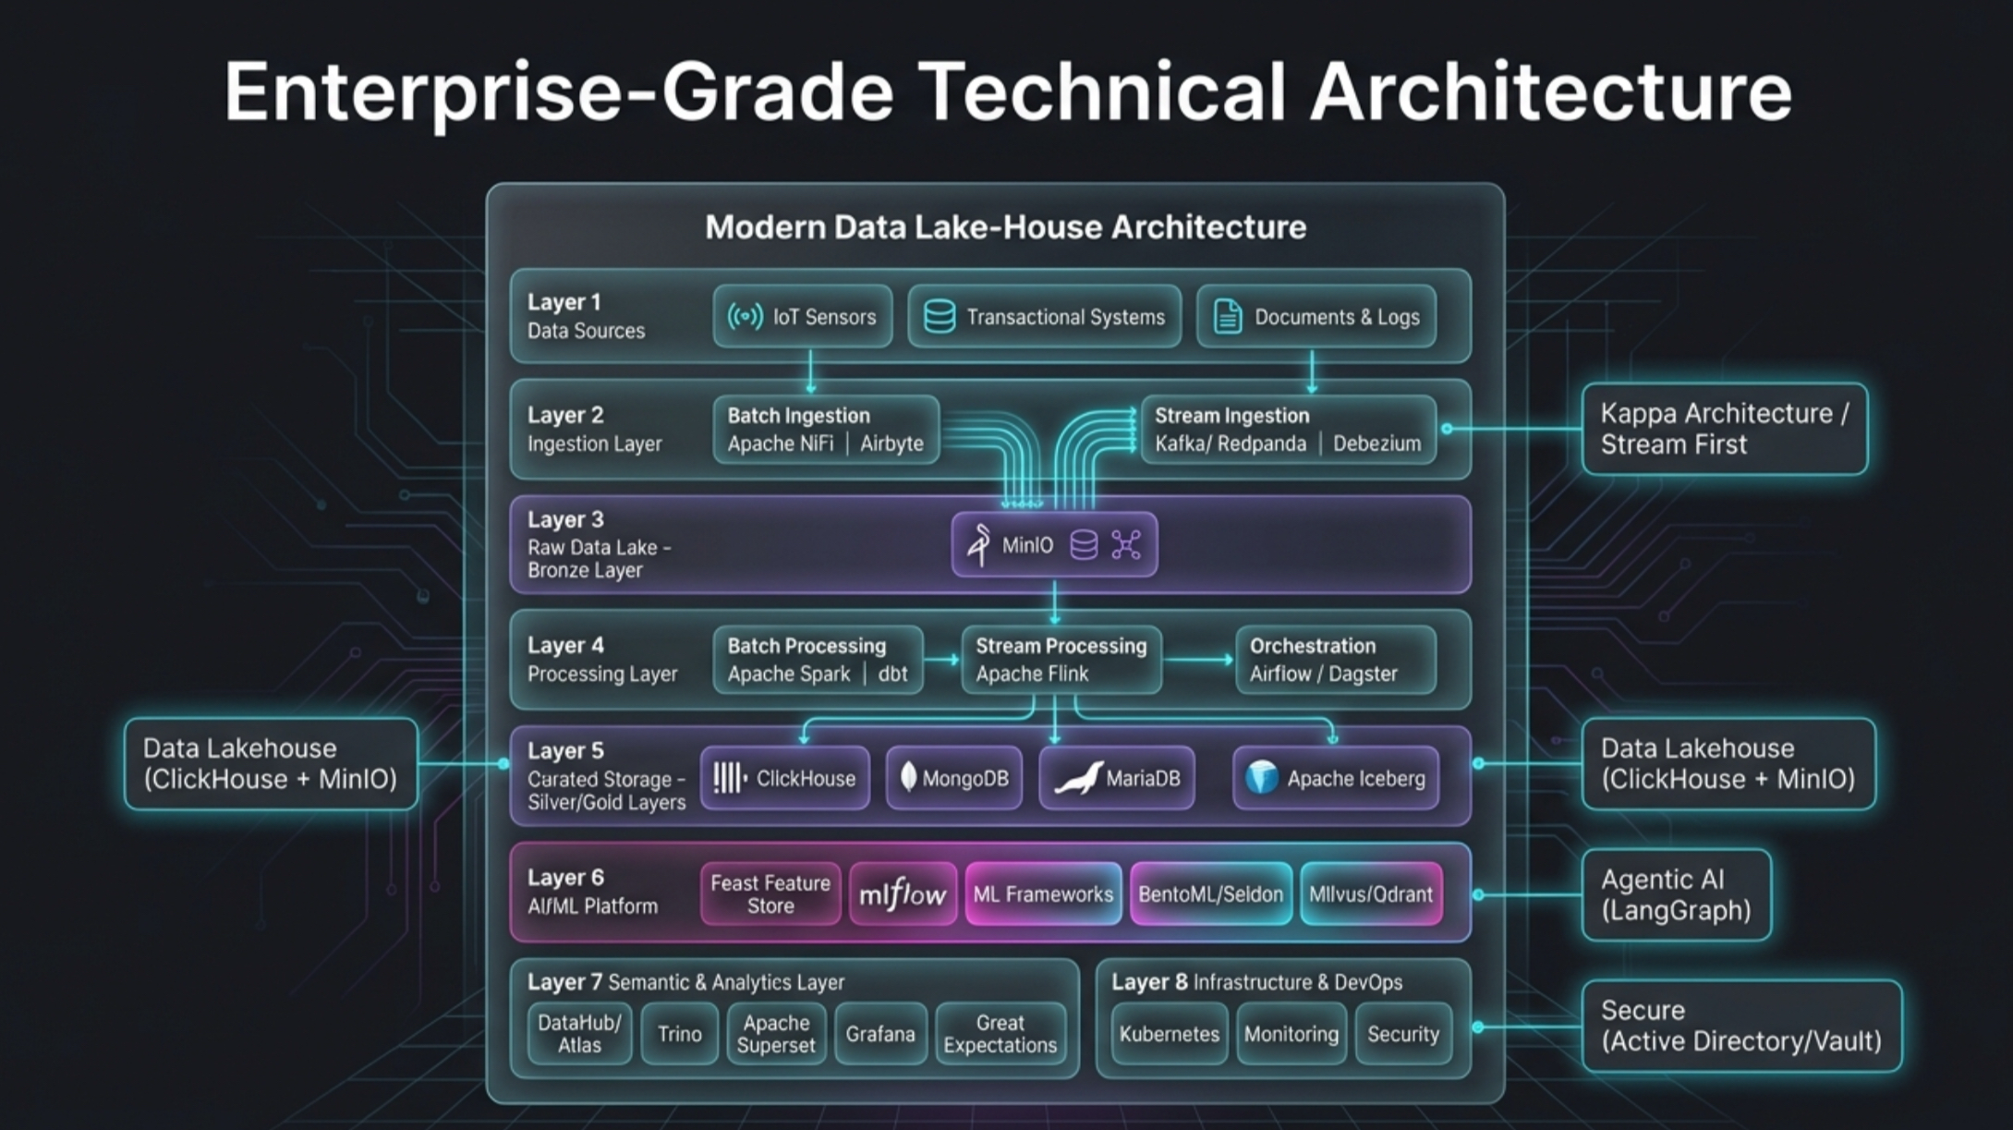

Slide 11
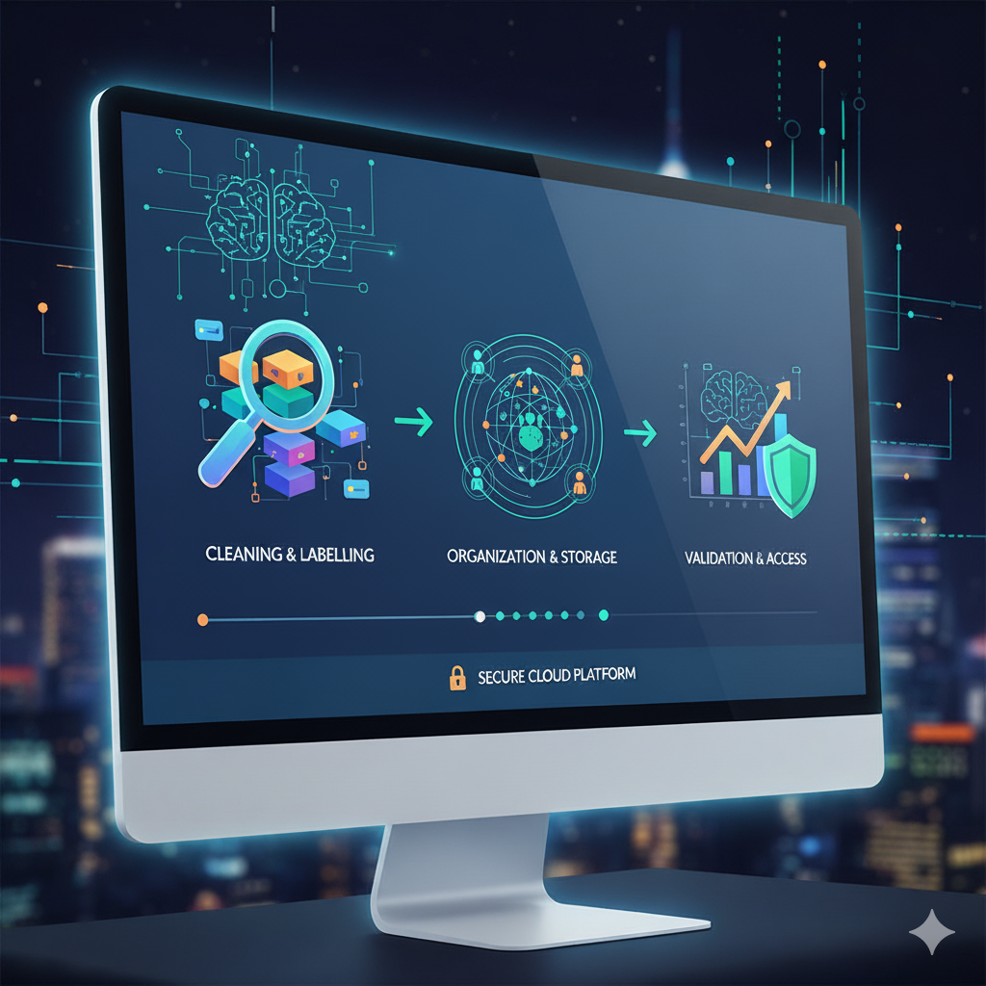


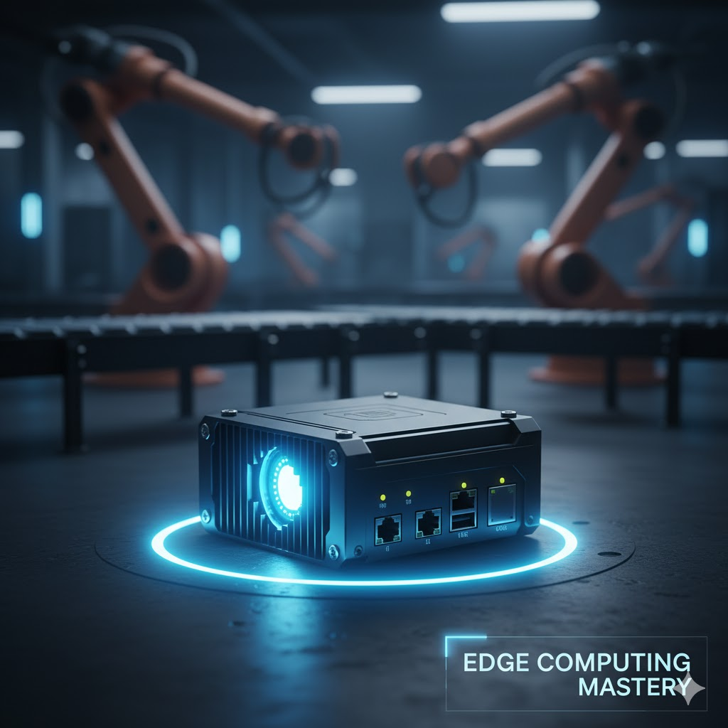
Under the Hood: Secure, Open and Future-Proof
EDGE COMPUTING
Enterprise grade Android OS
Linux
TensorFlow Lite
Supports air-gapped environments
CLOUD/ON-PREM CORE
Kubernetes Microservices
PostgreSQL
Apache Spark
SECURITY AND OPENNESS
Zero Trust Architecture
End to end encryption
INTEGRATION
REST
MQTT
OPC_UA
No vendor lock-in
Your data is your data
$8-12M+
Dark Data Loss
60-80% of machine data is never analyzed or captured

Slide 12
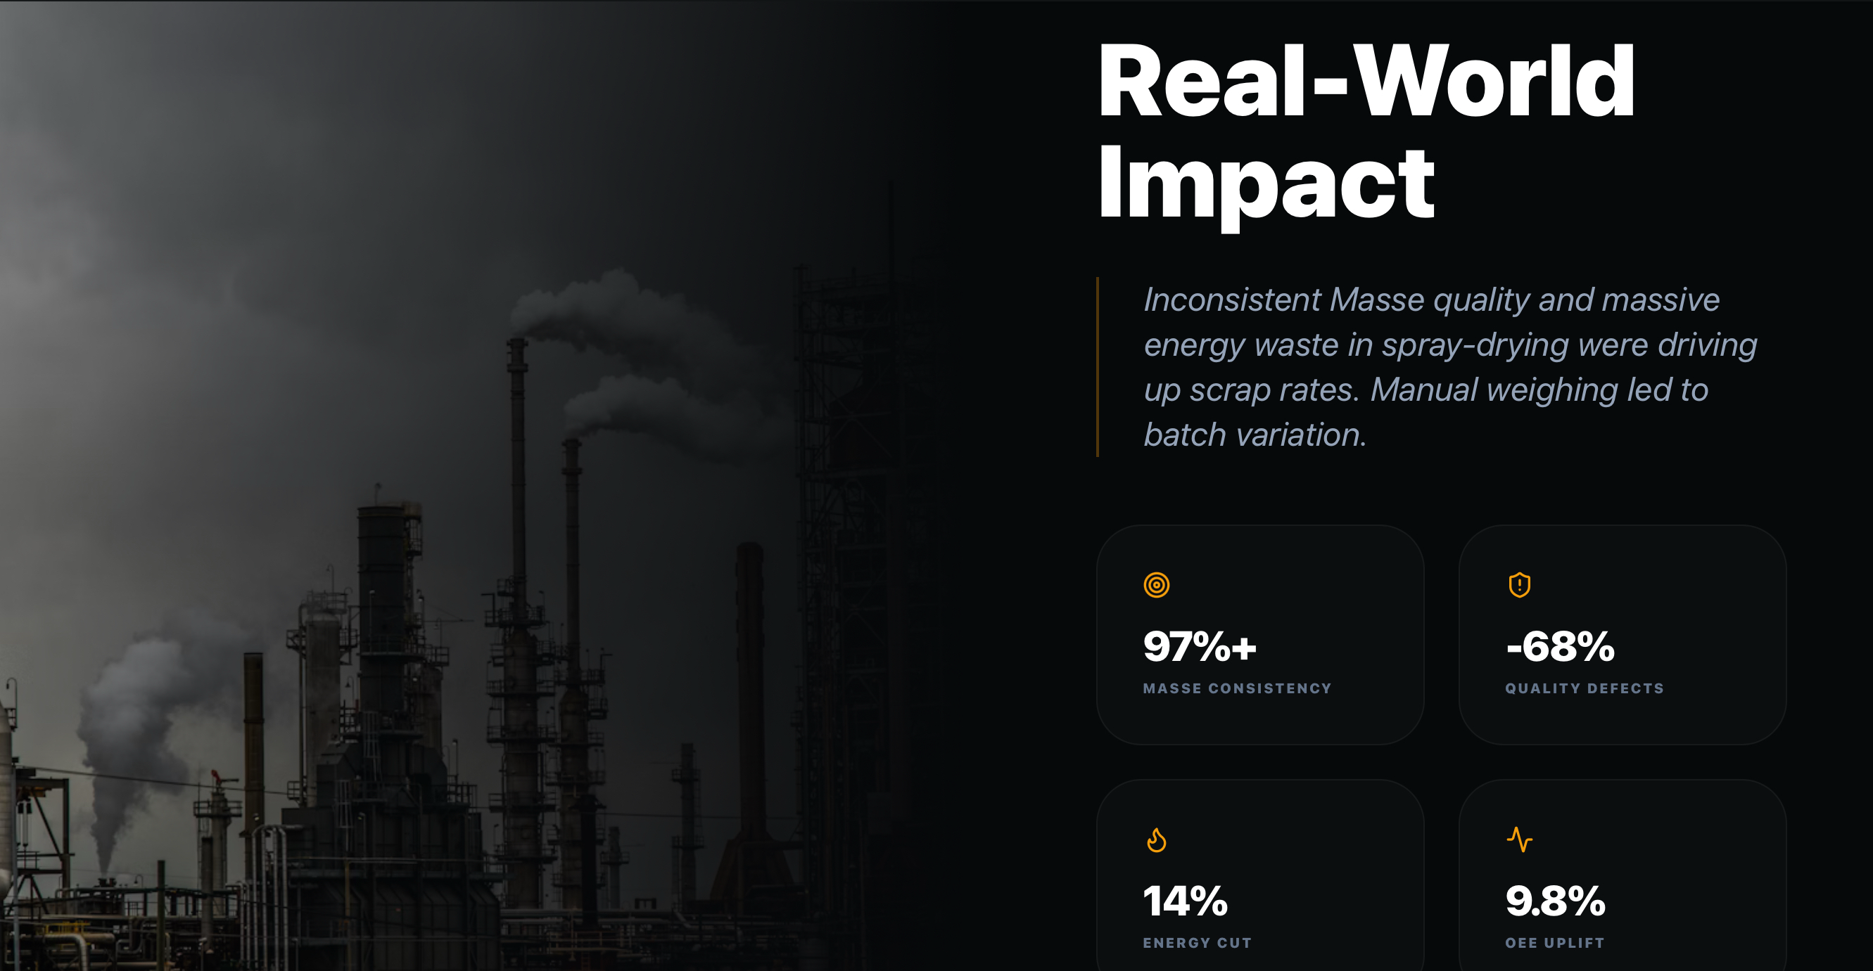
CERAMİC PRODUCTION – MASSE PLANT
TOTAL FINANCIAL IMPACT
$7.5M

Slide 13
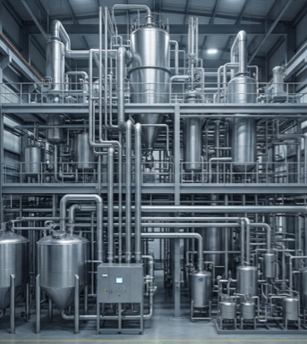

95%+ recipe accuracy
10-15% raw material cost optimization
Raw Materials
Factory
OBJECTIVES
Recipe forecasting by raw material and/or supplier
Achieve target quality ( and colour) with no extra dosing effort
Predict quality prior to spraying activity
Estimated Results (12 Months)
95%+
$2.8M
CHALLENGE
RECIPE ACCURACY
MATERIAL WASTE
68%
$1.9M
Incorrect weighing and dosing
Recipe deviations
Manual recipe adjustments
Difficulty adapting to raw material changes
QUALITY DEFECT ↓
QUALITY COST SAVING
14%
$1.2M
ENERGY REDUCTION
ENERGY SAVING
SOLUTION
9.8%
+$1.6M
OEE IMPROVEMENT
CAPACITY VALUE
RECIPE MANAGEMENT & OPTIMIZATION
GRINDING & MILLING OPTIMIZATION
SPRAY DRYING OPTIMIZATION
$7.5M Annual Impact
Notes:
Manual recipe adjustments yerine “No records of former processes” denebilir. Girdi olan Reçete + Ham Madde (Muadil ve/ya tedarikçi vs) ile çıktı olan Lab Sonuçları arası ilişki olmamasını tarif edecek şekilde

Slide 14
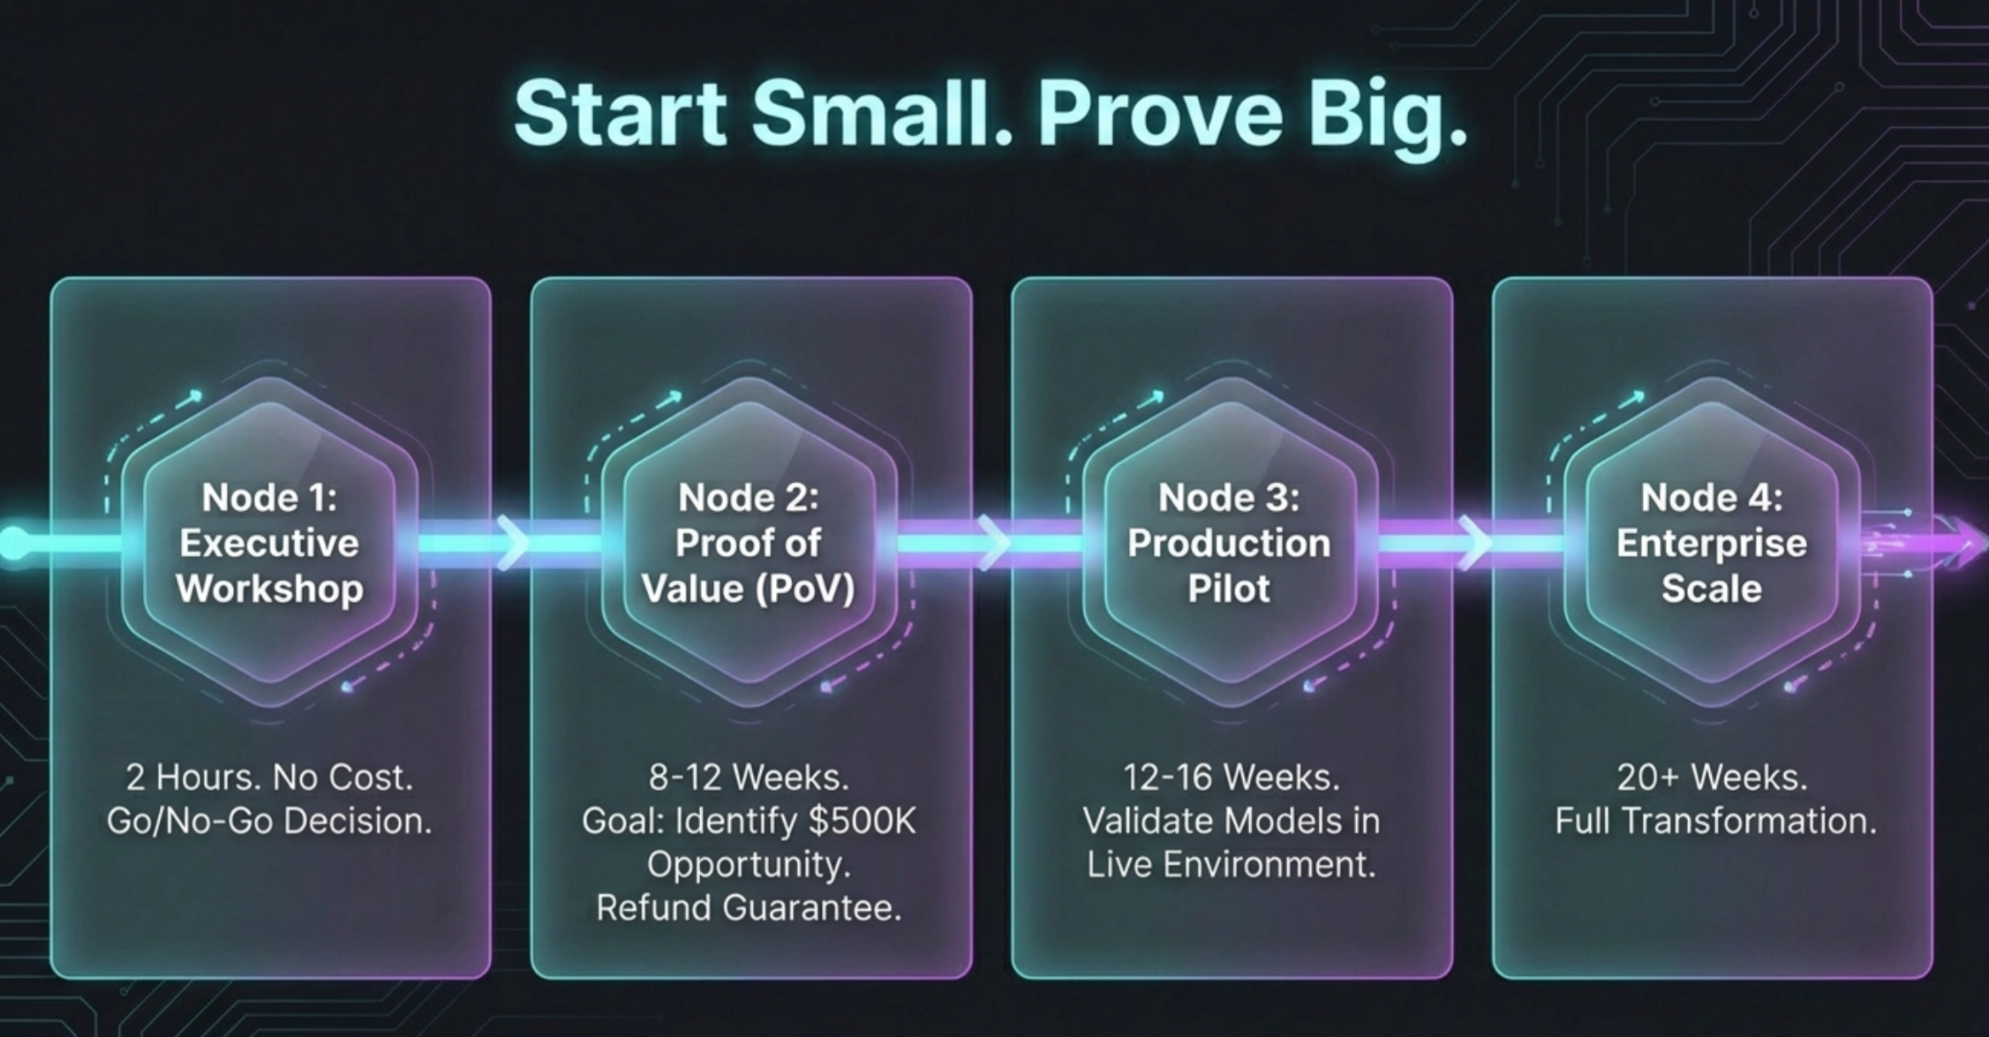

Slide 15
ROI CALCULATION
METHODOLOGY
Example: Dark Data Loss ($8-12M)
Quality Escapes
3-Year Investment
$500M × 2.5% defect rate$12.5M
Year 1: POV + Pilot$500K
× 60% preventable$7.5M
Year 2: Enterprise$6000K
Year 3: Optimization$700K
Reactive Maintenance
Total$7.2M
Manufacturing revenue: $500M
Typical COGS: 65-70% = $325-350M Manufacturing overhead: 15-20% = $75-100M
Target addressable loss: 10-16% of manufacturing costs
300 machines × $15K$4.5M
× 40% preventable$1.8M
Phased Returns
Year 1: 17.5% captured$7.5M
Energy Waste
Year 2: 45% cumulative$19.4M
$20M energy cost$20M
Year 3: 65% cumulative$28M
× 15% optimization$3.0M
3-Year ROI1,547%
Total Potential Cost Recovery
✓ Payback in 9 months
Conservative annual$12.3M
Note: after enterprise-wide implementation
300 machines, 24/7 ops, $5K/hr downtime, 65% COGS. Conservative 25th percentile assumptions.

Slide 16
COMPETITIVE LANDSCAPE
ARDICTECH
Siemens, AVEVA, SAP,Rockwell
ARCHITECTURE
Open / Modular (API First)
Fragmented Point Solutions
IMPLEMENTATIONS
Rapid Overlay:12-16 weeks pilots
24-52+ week projects
AI & INTERFACE
Chat With your Factory- Conversational ( no complex dashboards)
Bolt- 0n Anatytics, separate implementation
COST MODEL
Scalable ROI
BROWNFIELD FOCUS
Protocol-agnostic expertise,
Vendor-specific, limited compatibility

Slide 17
A De-Risked Engagement Path
From Pilot to Scale
STEP 1
EXECUTIVE WORKSHOP
2 Hours. No Cost.
Goal: go /No-Go Decision
STEP 2
PROOF OF VALUE
8-12 Weeks.
Goal: identify
USD 500 K Opp.
STEP 3
PRODUCTION PILOT
12-16 Weeks. KPI based
Goal:Validate Models
STEP 4
ENTERPRISE SCALE
20+Weeks.
Goal:
TRANSFORMATION
Notes:
Step2: 4 – 6 hafta olabilir aslında. Süreçlerini dinlemek, kabaca akışı çıkarmak, dar boğazları ve/ya problem noktalarını adreslemek için 6 hafta yeterli gelir sanki?

Slide 18

BUSINESS IMPACT & BENEFITS
Proven Business Impact Across All Operations
14-22 Mo
2-6%
3-5%
8-12 Wks
Typical ROI Payback
Revenue Improvement
EBITDA Expansion
Time to First Value
CFO / FINANCE
COO / OPERATIONS
CTO / TECHNOLOGY
Financial Performance
Operational Excellence
Technology Strategy
Protect revenue through quality & delivery improvements
Expand margins via waste reduction & energy optimization
Reduce working capital with inventory optimization
Mitigate compliance risk (FDA, ISO, carbon regulations)
No capital expenditure on new equipment
Increase OEE by 8-15% without new equipment
Reduce unplanned downtime 40-70%
Improve first-pass yield 15-35%
Enable predictive maintenance (prevent failures)
Gain real-time enterprise visibility across all plants
Overlay architecture preserves existing IT investments
Protocol-agnostic: integrate any system (OPC-UA, MQTT, REST)
Cloud or on-premise deployment flexibility
No vendor lock-in, open APIs, your data ownership
Future-proof with modular, scalable platform

Slide 19
Addressing Your Concerns
WE ALREADY HAVE MES
We don’t replace them, we connect them.
IS MY DATA SECURE ?
Yes. IgniteEdge processes critical data on-premise (at the edge). Sensitive data doesn’t leave your walls unless you authorize it.
WILL IT DISRUPT OPS?
No. Our ‘Overlay Strategy’ connects to read-only data ports. We are non-intrusive and do not stop machines for installation.
WHY ‘’CHAT’’ ?
We dont replace dashboards; we explain them. CWF is the ‘search Engine’ for your factory, floor managers don’t need to PhD to understand the data. They just ask.

Slide 20
Your Journey to Ensō Starts Here
Achieve Effortless Control
Master process complexity and empower your teams with AI-driven recommandations
Gain Unprecendented Clarity
Go beyond dashboards to see the true financial impact of every operational decision
Invest with Absolute Confidence
A de-risked, rapid path to tangible ROI,
info@ardictech.com
www.ardictech.com

